Slide 1

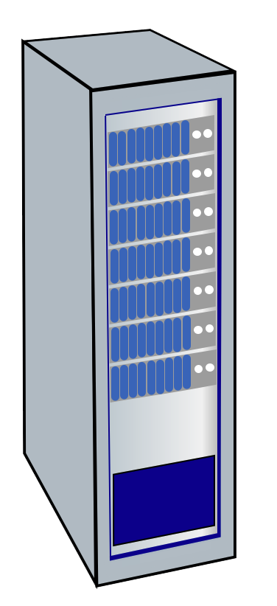




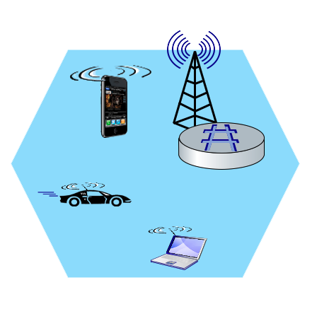
Elements of 4G LTE architecture
Mobile device:
smartphone, tablet, laptop, IoT, ... with 4G LTE radio
64-bit International Mobile Subscriber Identity (IMSI), stored on SIM (Subscriber Identity Module) card
LTE jargon: User Equipment (UE)
Mobility Management Entity (MME)
Home Subscriber Service (HSS)
Mobile device
(UE)
Base station
(eNode-B)
to
Internet
PDN gateway (P-GW)
…
Serving Gateway (S-GW)
radio access
network
all-IP Enhanced Packet Core (EPC)

Slide 2
Elements of 4G LTE architecture
Base station:
at “edge” of carrier’s network
manages wireless radio resources, mobile devices in its coverage area (“cell”)
coordinates device authentication with other elements
similar to WiFi AP but:
  active role in user mobility
  coordinates with nearly base stations to optimize radio use
LTE jargon: eNode-B
Mobility Management Entity (MME)
Home Subscriber Service (HSS)
Mobile device
(UE)
Base station
(eNode-B)
to
Internet
PDN gateway (P-GW)
…
Serving Gateway (S-GW)

Slide 3
Radio Access Network: 4G radio
Mobile device
(UE)
Base station
(eNode-B)
connects device (UE) to a base station (eNode-B)
  multiple devices connected to each base station
many different possible frequencies bands, multiple channels in each band
  popular bands: 600, 700, 850, 1500, 1700, 1900, 2100, 2600, 3500 MHz
  separate upstream and downstream channels
sharing 4G radio channel among users:
  OFDM: Orthogonal Frequency Division Multiplexing
  combination of FDM, TDM
100’s Mbps possible per user/device
Notes:
G-defined subbands are narrow (e.g., 15 kHz)

Slide 4
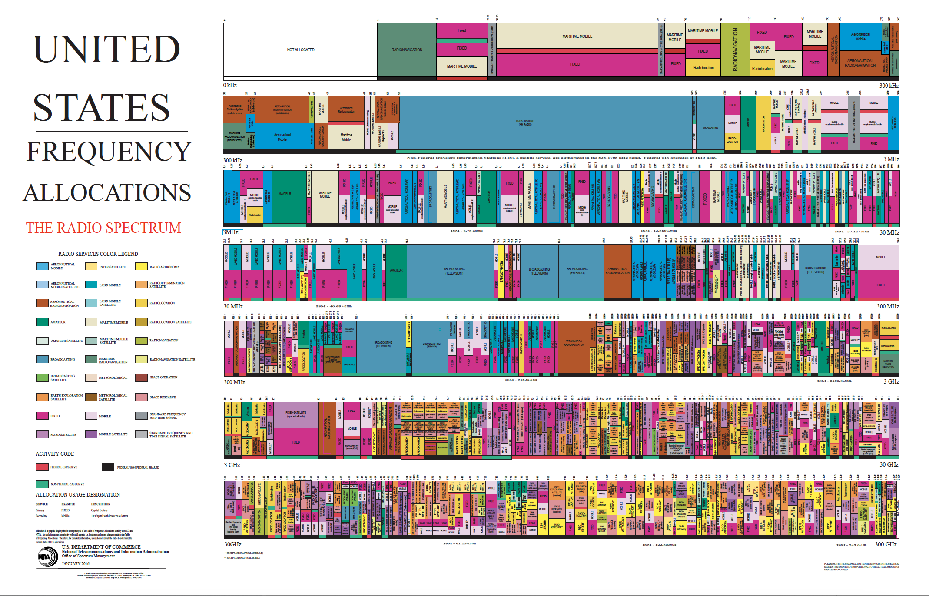
Spectrum
CBRS
Notes:
8 orders of magnitude: 9 Khz to 300 Ghz

Slide 5
OFDMA: time division (LTE)
Subcarrier frequencies
time (symbols)

Slide 6
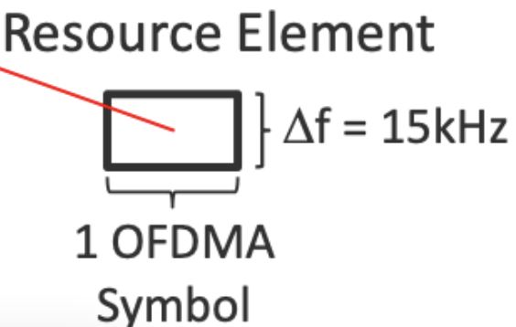
OFDMA: time division (LTE)
Physical Resource Block (PRB ): blocks of 7x12=84 resource elements
unit of transmission scheduling
Subcarrier frequencies
time to transmit one OFDM symbol on subcarrier frequency

Slide 7
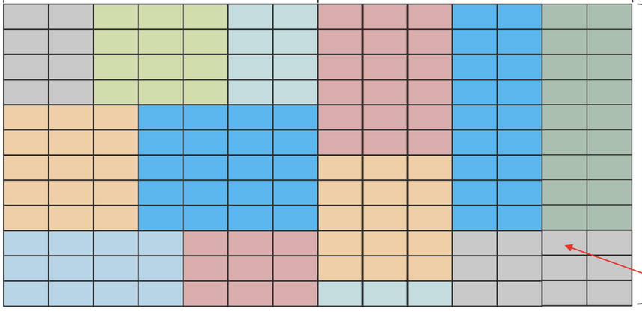
OFDMA:
Transmission Time Interval (TTI): 1 ms
PRB
PRB
Transmission scheduling example:
Send to 7 UEs in 7 blocks of REs in one PRB
Subcarrier frequencies
UE₁
UE₂
UE₃
UE₄
UE₅
UE₆
UE₇
time (symbols)

Slide 8
Elements of 4G LTE architecture
Home Subscriber Service
stores info about mobile devices for which the HSS’s network is their “home network”
works with MME in device authentication
Mobility Management Entity (MME)
Home Subscriber Service (HSS)
Mobile device
(UE)
Base station
(eNode-B)
to
Internet
PDN gateway (P-GW)
…
Serving Gateway (S-GW)

Slide 9
Elements of 4G LTE architecture
Serving Gateway (S-GW), PDN Gateway (P-GW)
lie on data path from mobile to/from Internet
P-GW
  gateway to mobile cellular network
  Looks like nay other internet gateway router
  provides NAT services
other routers:
  extensive use of tunneling
Mobility Management Entity (MME)
Home Subscriber Service (HSS)
Mobile device
(UE)
Base station
(eNode-B)
to
Internet
PDN gateway (P-GW)
…
Serving Gateway (S-GW)

Slide 10
Elements of 4G LTE architecture
Mobility Management Entity
device authentication (device-to-network, network-to-device) coordinated with mobile home network HSS
Mobility Management Entity (MME)
Home Subscriber Service (HSS)
Mobile device
(UE)
Base station
(eNode-B)
to
Internet
PDN gateway (P-GW)
mobile device management:
  device handover between cells
  tracking/paging device location
path (tunneling) setup from mobile device to P-GW
…
Serving Gateway (S-GW)

Slide 11
LTE: data plane control plane separation
HSS
control plane
new protocols for mobility management , security, authentication (later)
base station
MME
P-GW
S-GW
data plane
new protocols at link, physical layers
base station
S-GW
P-GW
extensive use of tunneling to facilitate mobility
IP tunnels

Slide 12
LTE data plane protocol stack: first hop
LTE link layer protocols:
Packet Data Convergence: header compression, encryption
Radio Link Control (RLC) Protocol: fragmentation/reassembly, reliable data transfer
Medium Access: requesting, use of radio transmission slots (OFDM)
Application
Transport
IP
IP
Packet Data
Convergence
Packet Data
Convergence
Link
Radio Link
Radio Link
Medium Access
Medium Access
Physical
Physical
data
plane
base station
S-GW
P-GW

Slide 13
LTE data plane protocol stack: packet core
tunneling:
mobile datagram encapsulated using GPRS Tunneling Protocol (GTP), sent inside UDP datagram to S-GW
S-GW re-tunnels datagrams to P-GW
supporting mobility: only tunneling endpoints change when mobile user moves
GTP-U
GTP-U
GTP-U
UDP
UDP
UDP
IP
IP
IP
IP
Packet Data
Convergence
Radio Link
link
link
link
Medium Access
Physical
Physical
Physical
Physical
\
base station
S-GW
P-GW

Slide 14
LTE data plane: associating with a BS
1
2
3
data
plane
base station
S-GW
P-GW
1
BS broadcasts primary synch signal every 5 ms on all frequencies
BSs from multiple carriers may be broadcasting synch signals
2
mobile finds a primary synch signal, then locates 2nd synch signal on this freq.
mobile then finds info broadcast by BS: channel bandwidth, configurations; BS’s cellular carrier info
mobile may get info from multiple base stations, multiple cellular networks
3
mobile selects which BS to associate with (e.g., preference for home carrier)
4
more steps still needed to authenticate, establish state, set up data plane

Slide 15
LTE mobiles: sleep modes
ZZZZ...
data
plane
as in WiFi, Bluetooth: LTE mobile may put radio to “sleep” to conserve battery:
light sleep: after 100’s msec of inactivity
  wake up periodically (100’s msec) to check for downstream transmissions
deep sleep: after 5-10 secs of inactivity
  mobile may change cells while deep sleeping – need to re-establish association

Slide 16
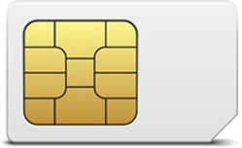
Global cellular network: a network of IP networks
home network HSS:
identify & services info, while in home network and roaming
Home
Subscriber
Server
home mobile
carrier network
P-GW
public Internet
and
inter-carrier IPX
all IP:
carriers interconnect with each other, and public internet at exchange points
legacy 2G, 3G: not all IP, handled otherwise
…
…
in home network
P-GW
SIM card: global identify info in home network
visited mobile
carrier network
…
roaming in visited network

