Slide 1
Code Division Multiple Access (CDMA)
unique “code” assigned to each user; i.e., code set partitioning
all users share same frequency, but each user has own “chipping” sequence (i.e., code) to encode data
allows multiple users to “coexist” and transmit simultaneously with minimal interference (if codes are “orthogonal”)
encoding: inner product: (original data) X (chipping sequence)
decoding: summed inner-product: (encoded data) X (chipping sequence)

Slide 2
CDMA encode/decode
channel output Z_{i,m}
Z_{i,m}= d_{i}.c_{m}
data
bits
d₀ = 1
1
1
1
1
1
d₁ = -1
1
1
1
-
-
-
-
1
-
-
-
1
-
1
1
1
1
1
sender
1
1
slot 1
channel
output
slot 0
channel
output
1
1
1
1
1
code
1
1
-
-
-
1
-
1
1
1
-
-
-
1
-
1
1
1
slot 1
slot 0
M
D_{i} = Σ Z_{i,m}.c_{m}
m=1
receiver
M
received
input
1
1
1
1
1
1
1
1
d₀ = 1
-
-
-
-
1
-
-
-
1
-
1
1
1
1
1
1
d₁ = -1
1
slot 1
channel
output
slot 0
channel
output
1
1
1
1
1
code
1
1
-
-
-
1
-
1
1
1
-
-
-
1
-
1
1
1
slot 1
slot 0
… but this isn’t really useful yet!

Slide 3
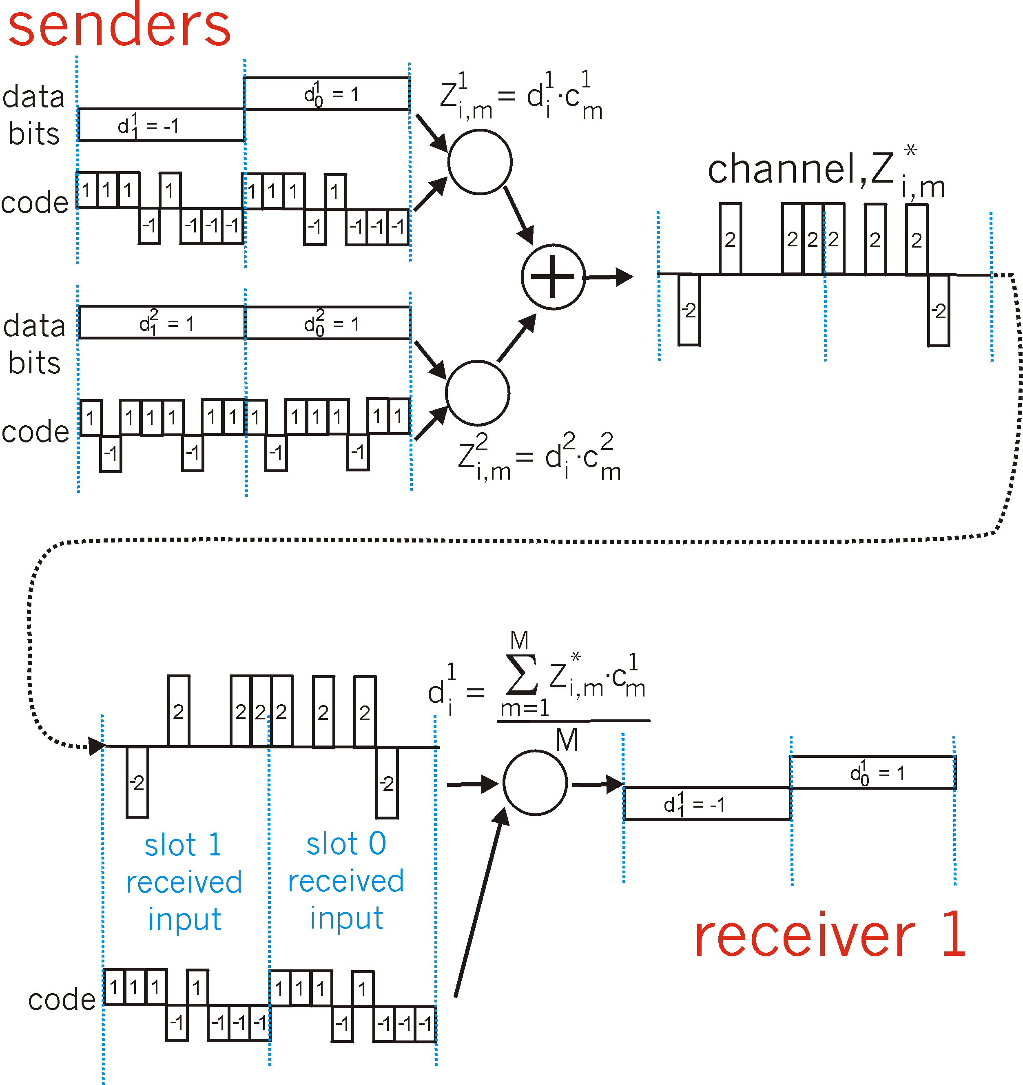
CDMA: two-sender interference
channel sums together transmissions by sender 1 and 2
Sender 1
Sender 2
using same code as sender 1, receiver recovers sender 1’s original data from summed channel data!
… now that’s useful!

