Slide 1
Chapter 7 Multimedia Networking
A note on the use of these ppt slides:
We’re making these slides freely available to all (faculty, students, readers). They’re in PowerPoint form so you can add, modify, and delete slides (including this one) and slide content to suit your needs. They obviously represent a lot of work on our part. In return for use, we only ask the following:
If you use these slides (e.g., in a class) in substantially unaltered form, that you mention their source (after all, we’d like people to use our book!)
If you post any slides in substantially unaltered form on a www site, that you note that they are adapted from (or perhaps identical to) our slides, and note our copyright of this material.
Thanks and enjoy! JFK / KWR
All material copyright 1996-2009
J.F Kurose and K.W. Ross, All Rights Reserved
Computer Networking: A Top Down Approach 5th edition. Jim Kurose, Keith Ross Addison-Wesley, April 2009.

Slide 2
Multimedia and Quality of Service: What is it?
multimedia applications: network audio and video
(“continuous media”)
QoS
network provides application with level of performance needed for application to function.

Slide 3
Chapter 7: goals
Principles
classify multimedia applications
identify network services applications need
making the best of best effort service
Protocols and Architectures
specific protocols for best-effort
mechanisms for providing QoS
architectures for QoS

Slide 4
Chapter 7 outline
7.1 multimedia networking applications
7.2 streaming stored audio and video
7.3 making the best out of best effort service
7.4 protocols for real-time interactive applications
RTP,RTCP,SIP
7.5 providing multiple classes of service
7.6 providing QoS guarantees

Slide 5
MM Networking Applications
Classes of MM applications:
1) stored streaming
2) live streaming
3) interactive, real-time
Fundamental characteristics:
typically delay sensitive
end-to-end delay
delay jitter
loss tolerant: infrequent losses cause minor glitches
antithesis of data, which are loss intolerant but delay tolerant.
Jitter is the variability
of packet delays within
the same packet stream

Slide 6
Streaming Stored Multimedia
Stored streaming:
media stored at source
transmitted to client
streaming: client playout begins before all data has arrived
timing constraint for still-to-be transmitted data: in time for playout

Slide 7
Streaming Stored Multimedia: What is it?
Cumulative data
2. video
sent
1. video
recorded
3. video received,
played out at client
network
delay
time
streaming: at this time, client
playing out early part of video,
while server still sending later
part of video

Slide 8
Streaming Stored Multimedia: Interactivity
VCR-like functionality: client can pause, rewind, FF, push slider bar
10 sec initial delay OK
1-2 sec until command effect OK
timing constraint for still-to-be transmitted data: in time for playout

Slide 9
Streaming Live Multimedia
Examples:
Internet radio talk show
live sporting event
Streaming (as with streaming stored multimedia)
playback buffer
playback can lag tens of seconds after transmission
still have timing constraint
Interactivity
fast forward impossible
rewind, pause possible!

Slide 10
Real-Time Interactive Multimedia
applications: IP telephony, video conference, distributed interactive worlds
end-end delay requirements:
audio: < 150 msec good, < 400 msec OK
includes application-level (packetization) and network delays
higher delays noticeable, impair interactivity
session initialization
how does callee advertise its IP address, port number, encoding algorithms?

Slide 11
Multimedia Over Today’s Internet
TCP/UDP/IP: “best-effort service”
no guarantees on delay, loss
?
?
?
?
?
?
But you said multimedia apps requires
QoS and level of performance to be
effective!
?
?
?
?
?
Today’s Internet multimedia applications
use application-level techniques to mitigate
(as best possible) effects of delay, loss

Slide 12
How should the Internet evolve to better support multimedia?
Integrated services philosophy:
fundamental changes in Internet so that apps can reserve end-to-end bandwidth
requires new, complex software in hosts & routers
Laissez-faire
no major changes
more bandwidth when needed
content distribution, application-layer multicast
application layer
Differentiated services philosophy:
fewer changes to Internet infrastructure, yet provide 1st and 2nd class service
What’s your opinion?

Slide 13
A few words about audio compression
analog signal sampled at constant rate
telephone: 8,000 samples/sec
CD music: 44,100 samples/sec
each sample quantized, i.e., rounded
e.g., 2⁸=256 possible quantized values
each quantized value represented by bits
8 bits for 256 values
example: 8,000 samples/sec, 256 quantized values --> 64,000 bps
receiver converts bits back to analog signal:
some quality reduction
Example rates
CD: 1.411 Mbps
MP3: 96, 128, 160 kbps
Internet telephony: 5.3 kbps and up

Slide 14
A few words about video compression
video: sequence of images displayed at constant rate
e.g. 24 images/sec
digital image: array of pixels
each pixel represented by bits
redundancy
spatial (within image)
temporal (from one image to next)
Examples:
MPEG 1 (CD-ROM) 1.5 Mbps
MPEG2 (DVD) 3-6 Mbps
MPEG4 (often used in Internet, < 1 Mbps)
Research:
layered (scalable) video
adapt layers to available bandwidth

Slide 15
Chapter 7 outline
7.1 multimedia networking applications
7.2 streaming stored audio and video
7.3 making the best out of best effort service
7.4 protocols for real-time interactive applications
RTP,RTCP,SIP
7.5 providing multiple classes of service
7.6 providing QoS guarantees

Slide 16
Streaming Stored Multimedia
application-level streaming techniques for making the best out of best effort service:
client-side buffering
use of UDP versus TCP
multiple encodings of multimedia
Media Player
jitter removal
decompression
error concealment
graphical user interface w/ controls for interactivity

Slide 17
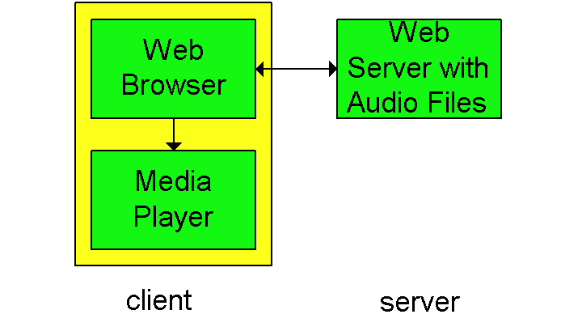
Internet multimedia: simplest approach
audio or video stored in file
files transferred as HTTP object
received in entirety at client
then passed to player
audio, video not streamed:
no, “pipelining,” long delays until playout!

Slide 18
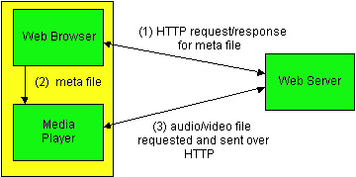
Internet multimedia: streaming approach
browser GETs metafile
browser launches player, passing metafile
player contacts server
server streams audio/video to player

Slide 19
Streaming from a streaming server
allows for non-HTTP protocol between server, media player
UDP or TCP for step (3), more shortly

Slide 20
Streaming Multimedia: Client Buffering
constant bit
rate video
transmission
client video
reception
constant bit
rate video
playout at client
Cumulative data
variable
network
delay
buffered
video
client playout
delay
time
client-side buffering, playout delay compensate for network-added delay, delay jitter

Slide 21
Streaming Multimedia: Client Buffering
constant
drain
rate, d
variable fill
rate, x(t)
buffered
video
client-side buffering, playout delay compensate for network-added delay, delay jitter

Slide 22
Streaming Multimedia: UDP or TCP?
UDP
server sends at rate appropriate for client (oblivious to network congestion !)
often send rate = encoding rate = constant rate
then, fill rate = constant rate - packet loss
short playout delay (2-5 seconds) to remove network jitter
error recover: time permitting
TCP
send at maximum possible rate under TCP
fill rate fluctuates due to TCP congestion control
larger playout delay: smooth TCP delivery rate
HTTP/TCP passes more easily through firewalls

Slide 23
Streaming Multimedia: client rate(s)
1.5 Mbps encoding
28.8 Kbps encoding
Q: how to handle different client receive rate capabilities?
28.8 Kbps dialup
100 Mbps Ethernet
A: server stores, transmits multiple copies of video, encoded at different rates

Slide 24
User Control of Streaming Media: RTSP
HTTP
does not target multimedia content
no commands for fast forward, etc.
RTSP: RFC 2326
client-server application layer protocol
user control: rewind, fast forward, pause, resume, repositioning, etc…
What it doesn’t do:
doesn’t define how audio/video is encapsulated for streaming over network
doesn’t restrict how streamed media is transported (UDP or TCP possible)
doesn’t specify how media player buffers audio/video

Slide 25
RTSP: out of band control
FTP uses an “out-of-band” control channel:
file transferred over one TCP connection.
control info (directory changes, file deletion, rename) sent over separate TCP connection
“out-of-band”, “in-band” channels use different port numbers
RTSP messages also sent out-of-band:
RTSP control messages use different port numbers than media stream: out-of-band.
port 554
media stream is considered “in-band”.

Slide 26
RTSP Example
Scenario:
metafile communicated to web browser
browser launches player
player sets up an RTSP control connection, data connection to streaming server

Slide 27
Metafile Example
<title>Twister</title>
<session>
<group language=en lipsync>
<switch>
<track type=audio
e="PCMU/8000/1"
src = "rtsp://audio.example.com/twister/audio.en/lofi">
<track type=audio
e="DVI4/16000/2" pt="90 DVI4/8000/1"
src="rtsp://audio.example.com/twister/audio.en/hifi">
</switch>
<track type="video/jpeg"
src="rtsp://video.example.com/twister/video">
</group>
</session>

Slide 28
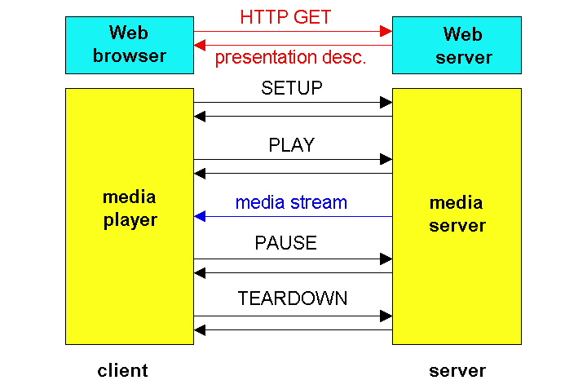
RTSP Operation

Slide 29
RTSP Exchange Example
C: SETUP rtsp://audio.example.com/twister/audio RTSP/1.0
Transport: rtp/udp; compression; port=3056; mode=PLAY
S: RTSP/1.0 200 1 OK
Session 4231
C: PLAY rtsp://audio.example.com/twister/audio.en/lofi RTSP/1.0
Session: 4231
Range: npt=0-
C: PAUSE rtsp://audio.example.com/twister/audio.en/lofi RTSP/1.0
Session: 4231
Range: npt=37
C: TEARDOWN rtsp://audio.example.com/twister/audio.en/lofi RTSP/1.0
Session: 4231
S: 200 3 OK

Slide 30
Chapter 7 outline
7.1 multimedia networking applications
7.2 streaming stored audio and video
7.3 making the best out of best effort service
7.4 protocols for real-time interactive applications
RTP,RTCP,SIP
7.5 providing multiple classes of service
7.6 providing QoS guarantees

Slide 31
Real-time interactive applications
PC-2-PC phone
Skype
PC-2-phone
Dialpad
Net2phone
Skype
videoconference with webcams
Skype
Polycom
Going to now look at a PC-2-PC Internet phone example in detail

Slide 32
Interactive Multimedia: Internet Phone
Introduce Internet Phone by way of an example
speaker’s audio: alternating talk spurts, silent periods.
64 kbps during talk spurt
pkts generated only during talk spurts
20 msec chunks at 8 Kbytes/sec: 160 bytes data
application-layer header added to each chunk.
chunk+header encapsulated into UDP segment.
application sends UDP segment into socket every 20 msec during talkspurt

Slide 33
Internet Phone: Packet Loss and Delay
network loss: IP datagram lost due to network congestion (router buffer overflow)
delay loss: IP datagram arrives too late for playout at receiver
delays: processing, queueing in network; end-system (sender, receiver) delays
typical maximum tolerable delay: 400 ms
loss tolerance: depending on voice encoding, losses concealed, packet loss rates between 1% and 10% can be tolerated.

Slide 34
Delay Jitter
constant bit
rate
transmission
client
reception
constant bit
rate playout
at client
Cumulative data
variable
network
delay
(jitter)
buffered
data
client playout
delay
time
consider end-to-end delays of two consecutive packets: difference can be more or less than 20 msec (transmission time difference)

Slide 35
Internet Phone: Fixed Playout Delay
receiver attempts to playout each chunk exactly q msecs after chunk was generated.
chunk has time stamp t: play out chunk at t+q .
chunk arrives after t+q: data arrives too late for playout, data “lost”
tradeoff in choosing q:
large q: less packet loss
small q: better interactive experience

Slide 36
Fixed Playout Delay
sender generates packets every 20 msec during talk spurt.
first packet received at time r
first playout schedule: begins at p
second playout schedule: begins at p’

Slide 37
Adaptive Playout Delay (1)
Goal: minimize playout delay, keeping late loss rate low
Approach: adaptive playout delay adjustment:
estimate network delay, adjust playout delay at beginning of each talk spurt.
silent periods compressed and elongated.
chunks still played out every 20 msec during talk spurt.
dynamic estimate of average delay at receiver:
where u is a fixed constant (e.g., u = .01).

Slide 38
Adaptive playout delay (2)
also useful to estimate average deviation of delay, v_{i} :
estimates d_{i} , v_{i} calculated for every received packet
(but used only at start of talk spurt
for first packet in talk spurt, playout time is:
where K is positive constant
remaining packets in talkspurt are played out periodically

Slide 39
Adaptive Playout (3)
Q: How does receiver determine whether packet is first in a talkspurt?
if no loss, receiver looks at successive timestamps.
difference of successive stamps > 20 msec -->talk spurt begins.
with loss possible, receiver must look at both time stamps and sequence numbers.
difference of successive stamps > 20 msec and sequence numbers without gaps --> talk spurt begins.

Slide 40
Recovery from packet loss (1)
Forward Error Correction (FEC): simple scheme
for every group of n chunks create redundant chunk by exclusive OR-ing n original chunks
send out n+1 chunks, increasing bandwidth by factor 1/n.
can reconstruct original n chunks if at most one lost chunk from n+1 chunks
playout delay: enough time to receive all n+1 packets
tradeoff:
increase n, less bandwidth waste
increase n, longer playout delay
increase n, higher probability that 2 or more chunks will be lost

Slide 41
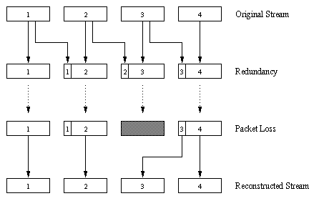
Recovery from packet loss (2)
2nd FEC scheme
“piggyback lower quality stream”
send lower resolution audio stream as redundant information
e.g., nominal stream PCM at 64 kbps and redundant stream GSM at 13 kbps.
whenever there is non-consecutive loss, receiver can conceal the loss.
can also append (n-1)st and (n-2)nd low-bit rate chunk

Slide 42
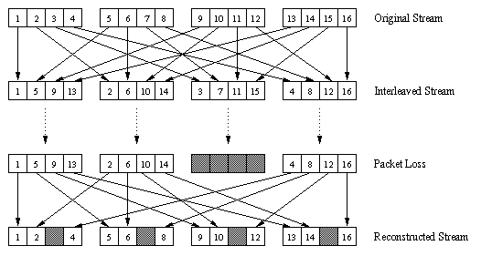
Recovery from packet loss (3)
Interleaving
chunks divided into smaller units
for example, four 5 msec units per chunk
packet contains small units from different chunks
if packet lost, still have most of every chunk
no redundancy overhead, but increases playout delay

Slide 43
Content distribution networks (CDNs)
Content replication
challenging to stream large files (e.g., video) from single origin server in real time
solution: replicate content at hundreds of servers throughout Internet
content downloaded to CDN servers ahead of time
placing content “close” to user avoids impairments (loss, delay) of sending content over long paths
CDN server typically in edge/access network
origin server
in North America
CDN distribution node
CDN server
in S. America
CDN server
in Asia
CDN server
in Europe

Slide 44
Content distribution networks (CDNs)
Content replication
CDN (e.g., Akamai) customer is the content provider (e.g., CNN)
CDN replicates customers’ content in CDN servers.
when provider updates content, CDN updates servers
origin server
in North America
CDN distribution node
CDN server
in S. America
CDN server
in Asia
CDN server
in Europe

Slide 45
CDN example
HTTP request for
www.foo.com/sports/sports.html
origin server
1
2
DNS query for www.cdn.com
client
CDN’s authoritative
DNS server
3
HTTP request for
www.cdn.com/www.foo.com/sports/ruth.gif
CDN server near client
origin server (www.foo.com)
distributes HTML
replaces:
http://www.foo.com/sports.ruth.gif
with http://www.cdn.com/www.foo.com/sports/ruth.gif
CDN company (cdn.com)
distributes gif files
uses its authoritative DNS server to route redirect requests

Slide 46
More about CDNs
routing requests
CDN creates a “map”, indicating distances from leaf ISPs and CDN nodes
when query arrives at authoritative DNS server:
server determines ISP from which query originates
uses “map” to determine best CDN server
CDN nodes create application-layer overlay network

Slide 47
Summary: Internet Multimedia: bag of tricks
use UDP to avoid TCP congestion control (delays) for time-sensitive traffic
client-side adaptive playout delay: to compensate for delay
server side matches stream bandwidth to available client-to-server path bandwidth
chose among pre-encoded stream rates
dynamic server encoding rate
error recovery (on top of UDP)
FEC, interleaving, error concealment
retransmissions, time permitting
CDN: bring content closer to clients

Slide 48
Chapter 7 outline
7.1 multimedia networking applications
7.2 streaming stored audio and video
7.3 making the best out of best effort service
7.4 protocols for real-time interactive applications
RTP, RTCP, SIP
7.5 providing multiple classes of service
7.6 providing QoS guarantees

Slide 49
Real-Time Protocol (RTP)
RTP specifies packet structure for packets carrying audio, video data
RFC 3550
RTP packet provides
payload type identification
packet sequence numbering
time stamping
RTP runs in end systems
RTP packets encapsulated in UDP segments
interoperability: if two Internet phone applications run RTP, then they may be able to work together

Slide 50
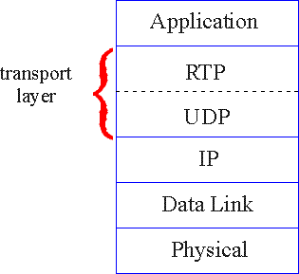
RTP runs on top of UDP
RTP libraries provide transport-layer interface
that extends UDP:
port numbers, IP addresses
payload type identification
packet sequence numbering
time-stamping

Slide 51
RTP Example
consider sending 64 kbps PCM-encoded voice over RTP.
application collects encoded data in chunks, e.g., every 20 msec = 160 bytes in a chunk.
audio chunk + RTP header form RTP packet, which is encapsulated in UDP segment
RTP header indicates type of audio encoding in each packet
sender can change encoding during conference.
RTP header also contains sequence numbers, timestamps.

Slide 52
RTP and QoS
RTP does not provide any mechanism to ensure timely data delivery or other QoS guarantees.
RTP encapsulation is only seen at end systems (not) by intermediate routers.
routers providing best-effort service, making no special effort to ensure that RTP packets arrive at destination in timely matter.

Slide 53
RTP Header
Payload Type (7 bits): Indicates type of encoding currently being used. If sender changes encoding in middle of conference, sender
informs receiver via payload type field.
Payload type 0: PCM mu-law, 64 kbps
Payload type 3, GSM, 13 kbps
Payload type 7, LPC, 2.4 kbps
Payload type 26, Motion JPEG
Payload type 31. H.261
Payload type 33, MPEG2 video
Sequence Number (16 bits): Increments by one for each RTP packet
sent, and may be used to detect packet loss and to restore packet
sequence.

Slide 54
RTP Header (2)
Timestamp field (32 bytes long): sampling instant of first byte in this RTP data packet
for audio, timestamp clock typically increments by one for each sampling period (for example, each 125 usecs for 8 KHz sampling clock)
if application generates chunks of 160 encoded samples, then timestamp increases by 160 for each RTP packet when source is active. Timestamp clock continues to increase at constant rate when source is inactive.
SSRC field (32 bits long): identifies source of t RTP stream. Each stream in RTP session should have distinct SSRC.

Slide 55
RTSP/RTP Programming Assignment
build a server that encapsulates stored video frames into RTP packets
grab video frame, add RTP headers, create UDP segments, send segments to UDP socket
include seq numbers and time stamps
client RTP provided for you
also write client side of RTSP
issue play/pause commands
server RTSP provided for you

Slide 56
Real-Time Control Protocol (RTCP)
works in conjunction with RTP.
each participant in RTP session periodically transmits RTCP control packets to all other participants.
each RTCP packet contains sender and/or receiver reports
report statistics useful to application: # packets sent, # packets lost, interarrival jitter, etc.
feedback can be used to control performance
sender may modify its transmissions based on feedback

Slide 57
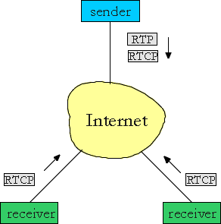
RTCP - Continued
each RTP session: typically a single multicast address; all RTP /RTCP packets belonging to session use multicast address.
RTP, RTCP packets distinguished from each other via distinct port numbers.
to limit traffic, each participant reduces RTCP traffic as number of conference participants increases

Slide 58
RTCP Packets
Receiver report packets:
fraction of packets lost, last sequence number, average interarrival jitter
Sender report packets:
SSRC of RTP stream, current time, number of packets sent, number of bytes sent
Source description packets:
e-mail address of sender, sender's name, SSRC of associated RTP stream
provide mapping between the SSRC and the user/host name

Slide 59
Synchronization of Streams
RTCP can synchronize different media streams within a RTP session
consider videoconferencing app for which each sender generates one RTP stream for video, one for audio.
timestamps in RTP packets tied to the video, audio sampling clocks
not tied to wall-clock time
each RTCP sender-report packet contains (for most recently generated packet in associated RTP stream):
timestamp of RTP packet
wall-clock time for when packet was created.
receivers uses association to synchronize playout of audio, video

Slide 60
RTCP Bandwidth Scaling
RTCP attempts to limit its traffic to 5% of session bandwidth.
Example
Suppose one sender, sending video at 2 Mbps. Then RTCP attempts to limit its traffic to 100 Kbps.
RTCP gives 75% of rate to receivers; remaining 25% to sender
75 kbps is equally shared among receivers:
with R receivers, each receiver gets to send RTCP traffic at 75/R kbps.
sender gets to send RTCP traffic at 25 kbps.
participant determines RTCP packet transmission period by calculating avg RTCP packet size (across entire session) and dividing by allocated rate

Slide 61
SIP: Session Initiation Protocol [RFC 3261]
SIP long-term vision:
all telephone calls, video conference calls take place over Internet
people are identified by names or e-mail addresses, rather than by phone numbers
you can reach callee, no matter where callee roams, no matter what IP device callee is currently using

Slide 62
SIP Services
Setting up a call, SIP provides mechanisms ..
for caller to let callee know she wants to establish a call
so caller, callee can agree on media type, encoding
to end call
determine current IP address of callee:
maps mnemonic identifier to current IP address
call management:
add new media streams during call
change encoding during call
invite others
transfer, hold calls

Slide 63
Setting up a call to known IP address
Alice’s SIP invite message indicates her port number, IP address, encoding she prefers to receive (PCM ulaw)
Bob’s 200 OK message indicates his port number, IP address, preferred encoding (GSM)
SIP messages can be sent over TCP or UDP; here sent over RTP/UDP.
default SIP port number is 5060.

Slide 64
Setting up a call (more)
codec negotiation:
suppose Bob doesn’t have PCM ulaw encoder.
Bob will instead reply with 606 Not Acceptable Reply, listing his encoders Alice can then send new INVITE message, advertising different encoder
rejecting a call
Bob can reject with replies “busy,” “gone,” “payment required,” “forbidden”
media can be sent over RTP or some other protocol

Slide 65
Example of SIP message
INVITE sip:bob@domain.com SIP/2.0
Via: SIP/2.0/UDP 167.180.112.24
From: sip:alice@hereway.com
To: sip:bob@domain.com
Call-ID: a2e3a@pigeon.hereway.com
Content-Type: application/sdp
Content-Length: 885
c=IN IP4 167.180.112.24
m=audio 38060 RTP/AVP 0
Notes:
HTTP message syntax
sdp = session description protocol
Call-ID is unique for every call.
Here we don’t know
Bob’s IP address.
Intermediate SIP servers needed.
Alice sends, receives SIP messages using SIP default port 506
Alice specifies in Via: header that SIP client sends, receives SIP messages over UDP

Slide 66
Name translation and user locataion
caller wants to call callee, but only has callee’s name or e-mail address.
need to get IP address of callee’s current host:
user moves around
DHCP protocol
user has different IP devices (PC, PDA, car device)
result can be based on:
time of day (work, home)
caller (don’t want boss to call you at home)
status of callee (calls sent to voicemail when callee is already talking to someone)
Service provided by SIP servers:
SIP registrar server
SIP proxy server

Slide 67
SIP Registrar
when Bob starts SIP client, client sends SIP REGISTER message to Bob’s registrar server
(similar function needed by Instant Messaging)
Register Message:
REGISTER sip:domain.com SIP/2.0
Via: SIP/2.0/UDP 193.64.210.89
From: sip:bob@domain.com
To: sip:bob@domain.com
Expires: 3600

Slide 68
SIP Proxy
Alice sends invite message to her proxy server
contains address sip:bob@domain.com
proxy responsible for routing SIP messages to callee
possibly through multiple proxies.
callee sends response back through the same set of proxies.
proxy returns SIP response message to Alice
contains Bob’s IP address
proxy analogous to local DNS server

Slide 69
Example
Caller jim@umass.edu with places a
call to keith@upenn.edu
(1) Jim sends INVITE message to umass SIP proxy. (2) Proxy forwards request to upenn registrar server. (3) upenn server returns redirect response, indicating that it should try keith@eurecom.fr
(4) umass proxy sends INVITE to eurecom registrar. (5) eurecom registrar forwards INVITE to 197.87.54.21, which is running keith’s SIP client. (6-8) SIP response sent back (9) media sent directly
between clients.
Note: also a SIP ack message, which is not shown.

Slide 70
Comparison with H.323
H.323 is another signaling protocol for real-time, interactive
H.323 is a complete, vertically integrated suite of protocols for multimedia conferencing: signaling, registration, admission control, transport, codecs
SIP is a single component. Works with RTP, but does not mandate it. Can be combined with other protocols, services
H.323 comes from the ITU (telephony).
SIP comes from IETF: Borrows much of its concepts from HTTP
SIP has Web flavor, whereas H.323 has telephony flavor.
SIP uses the KISS principle: Keep it simple stupid.

Slide 71
Chapter 7 outline
7.1 multimedia networking applications
7.2 streaming stored audio and video
7.3 making the best out of best effort service
7.4 protocols for real-time interactive applications
RTP, RTCP, SIP
7.5 providing multiple classes of service
7.6 providing QoS guarantees

Slide 72
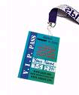
Providing Multiple Classes of Service
thus far: making the best of best effort service
one-size fits all service model
alternative: multiple classes of service
partition traffic into classes
network treats different classes of traffic differently (analogy: VIP service vs regular service)
granularity: differential service among multiple classes, not among individual connections
history: ToS bits
0111

Slide 73
Multiple classes of service: scenario
H1
H3
R1
R2
H4
H2
R1 output
interface
queue
1.5 Mbps link

Slide 74
Scenario 1: mixed FTP and audio
Example: 1Mbps IP phone, FTP share 1.5 Mbps link.
bursts of FTP can congest router, cause audio loss
want to give priority to audio over FTP
R1
R2
Principle 1
packet marking needed for router to distinguish between different classes; and new router policy to treat packets accordingly

Slide 75
Principles for QOS Guarantees (more)
what if applications misbehave (audio sends higher than declared rate)
policing: force source adherence to bandwidth allocations
marking and policing at network edge:
similar to ATM UNI (User Network Interface)
1 Mbps
phone
R1
R2
1.5 Mbps link
packet marking and policing
Principle 2
provide protection (isolation) for one class from others

Slide 76
Principles for QOS Guarantees (more)
Allocating fixed (non-sharable) bandwidth to flow: inefficient use of bandwidth if flows doesn’t use its allocation
1 Mbps
phone
1 Mbps logical link
R1
R2
1.5 Mbps link
0.5 Mbps logical link
Principle 3
While providing isolation, it is desirable to use
resources as efficiently as possible

Slide 77
Scheduling And Policing Mechanisms
scheduling: choose next packet to send on link
FIFO (first in first out) scheduling: send in order of arrival to queue
real-world example?
discard policy: if packet arrives to full queue: who to discard?
Tail drop: drop arriving packet
priority: drop/remove on priority basis
random: drop/remove randomly

Slide 78
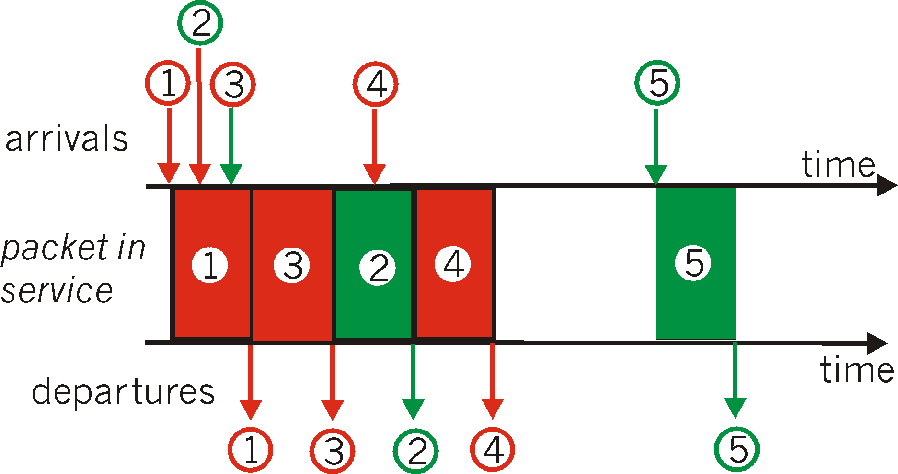
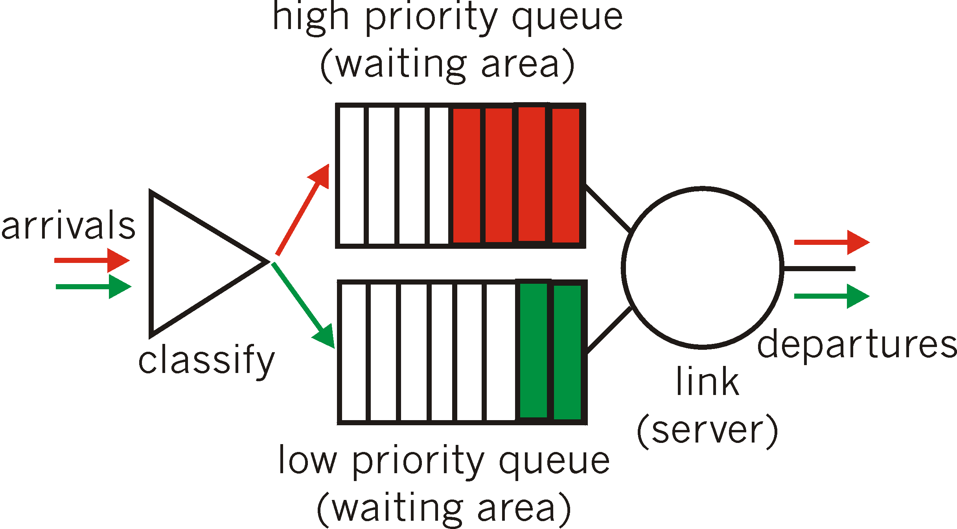
Scheduling Policies: more
Priority scheduling: transmit highest priority queued packet
multiple classes, with different priorities
class may depend on marking or other header info, e.g. IP source/dest, port numbers, etc..
Real world example?

Slide 79
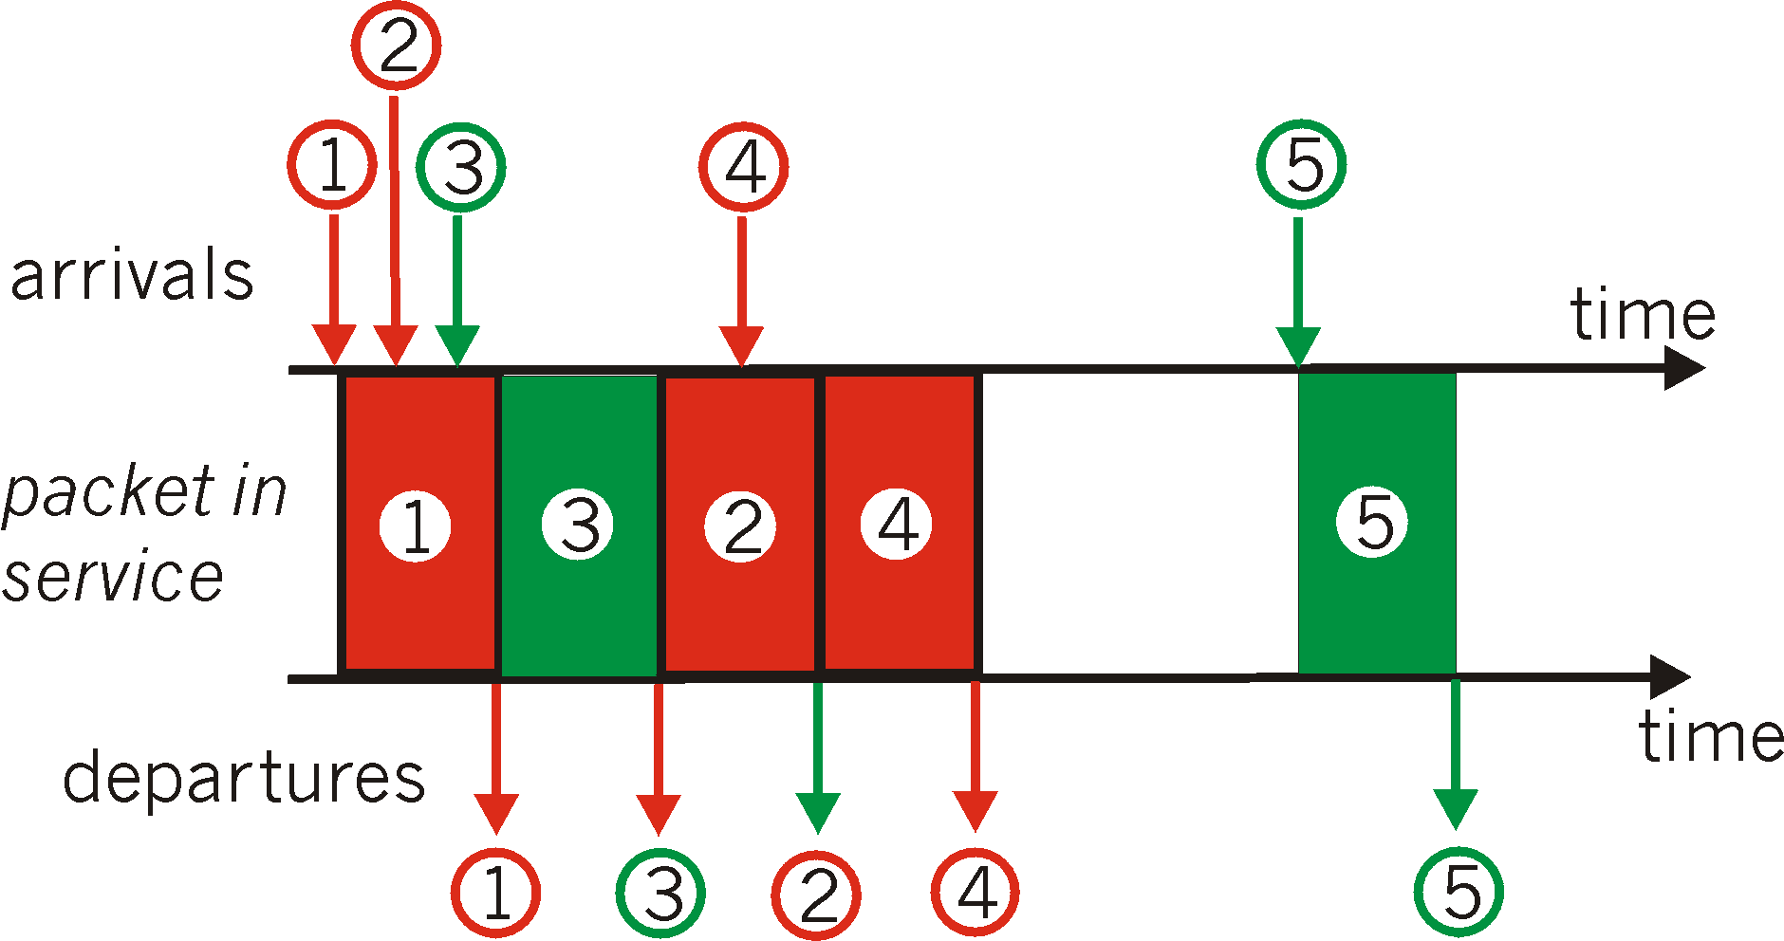
Scheduling Policies: still more
round robin scheduling:
multiple classes
cyclically scan class queues, serving one from each class (if available)
real world example?

Slide 80
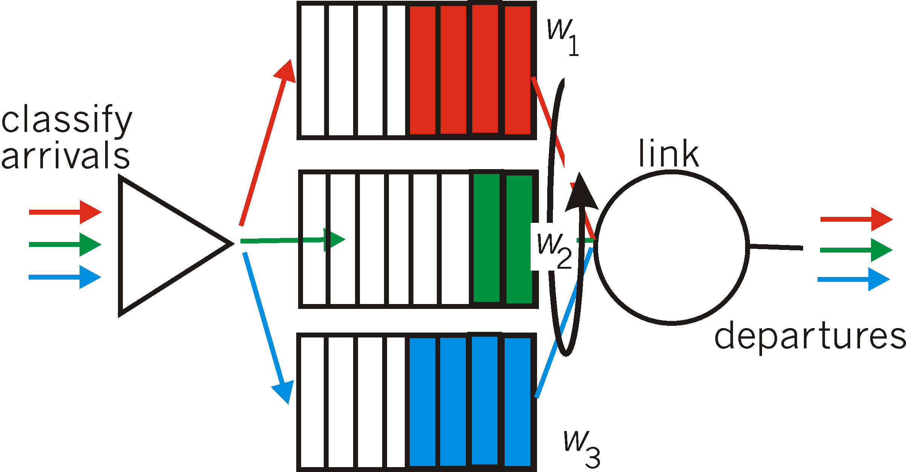
Scheduling Policies: still more
Weighted Fair Queuing:
generalized Round Robin
each class gets weighted amount of service in each cycle
real-world example?

Slide 81
Policing Mechanisms
Goal: limit traffic to not exceed declared parameters
Three common-used criteria:
(Long term) Average Rate: how many pkts can be sent per unit time (in the long run)
crucial question: what is the interval length: 100 packets per sec or 6000 packets per min have same average!
Peak Rate: e.g., 6000 pkts per min. (ppm) avg.; 1500 ppm peak rate
(Max.) Burst Size: max. number of pkts sent consecutively (with no intervening idle)

Slide 82
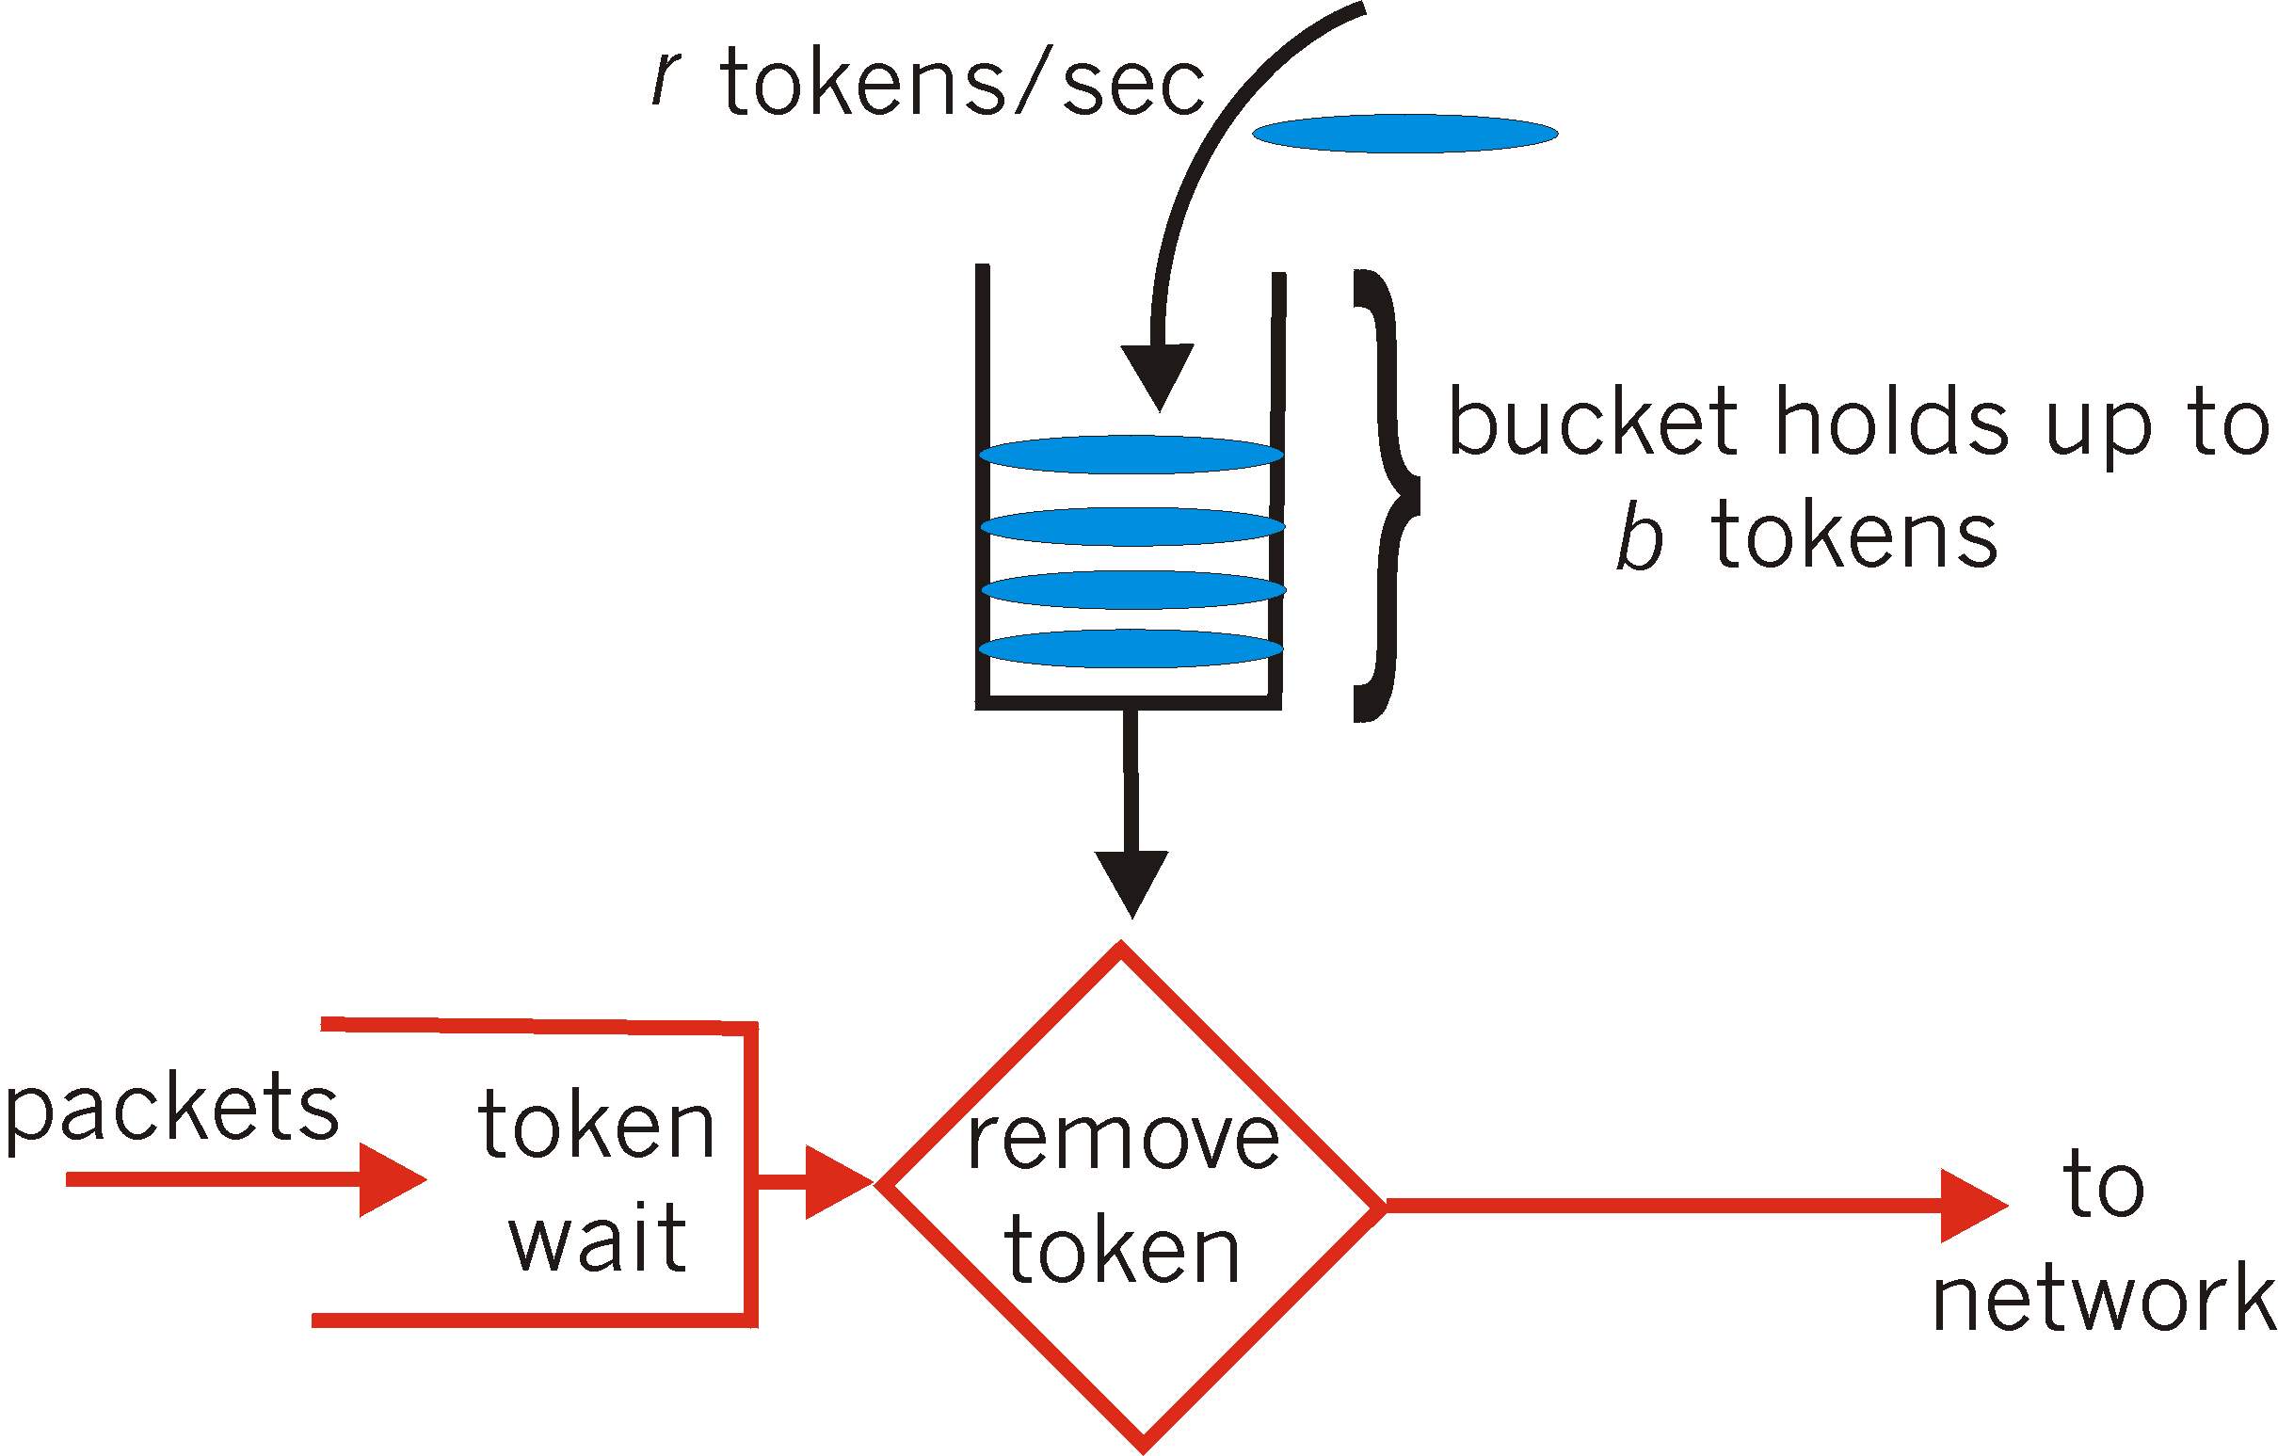
Policing Mechanisms
Token Bucket: limit input to specified Burst Size and Average Rate.
bucket can hold b tokens
tokens generated at rate r token/sec unless bucket full
over interval of length t: number of packets admitted less than or equal to (r t + b).

Slide 83
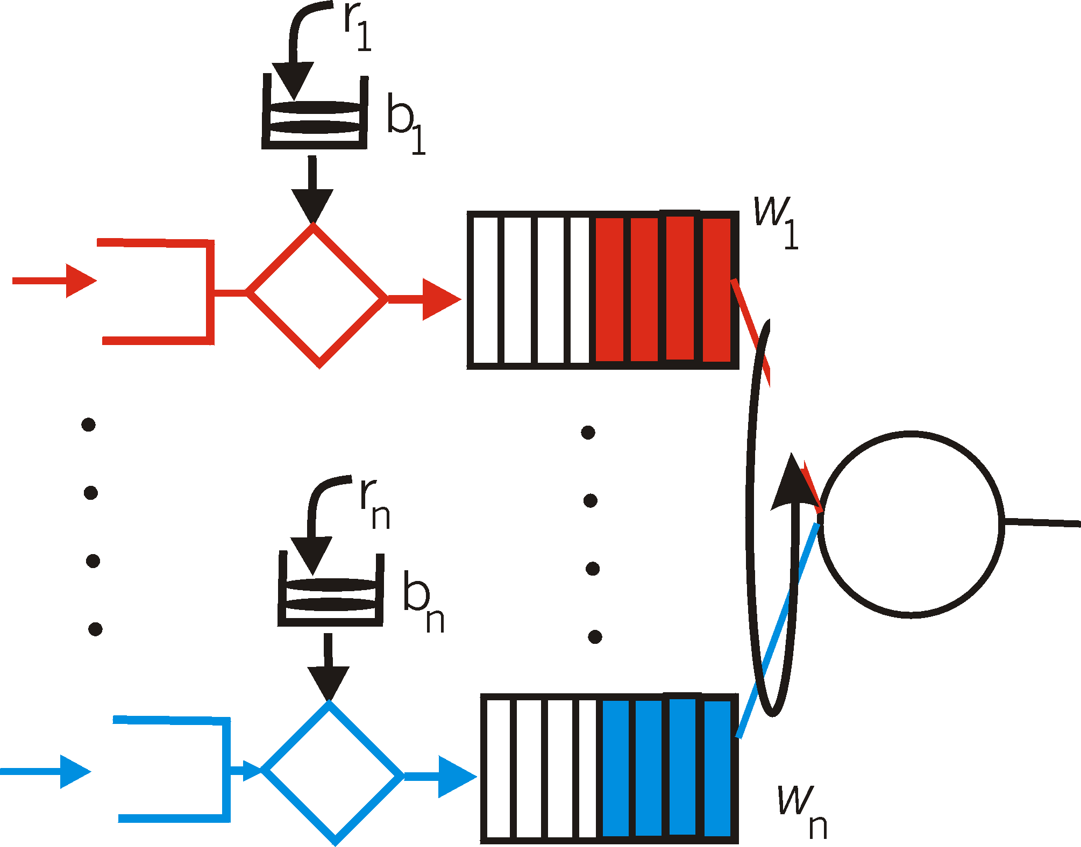
Policing Mechanisms (more)
token bucket, WFQ combine to provide guaranteed upper bound on delay, i.e., QoS guarantee!
arriving
traffic
token rate, r
bucket size, b
per-flow
rate, R
WFQ
D = b/R
max

Slide 84
IETF Differentiated Services
want “qualitative” service classes
“behaves like a wire”
relative service distinction: Platinum, Gold, Silver
scalability: simple functions in network core, relatively complex functions at edge routers (or hosts)
signaling, maintaining per-flow router state difficult with large number of flows
don’t define define service classes, provide functional components to build service classes

Slide 85
Diffserv Architecture
Edge router:
per-flow traffic management
marks packets as in-profile and out-profile
marking
r
scheduling
.
b
.
.
Core router:
per class traffic management
buffering and scheduling based on marking at edge
preference given to in-profile packets

Slide 86
Edge-router Packet Marking
profile: pre-negotiated rate A, bucket size B
packet marking at edge based on per-flow profile
Rate A
B
User packets
Possible usage of marking:
class-based marking: packets of different classes marked differently
intra-class marking: conforming portion of flow marked differently than non-conforming one

Slide 87
Classification and Conditioning
Packet is marked in the Type of Service (TOS) in IPv4, and Traffic Class in IPv6
6 bits used for Differentiated Service Code Point (DSCP) and determine PHB that the packet will receive
2 bits are currently unused

Slide 88
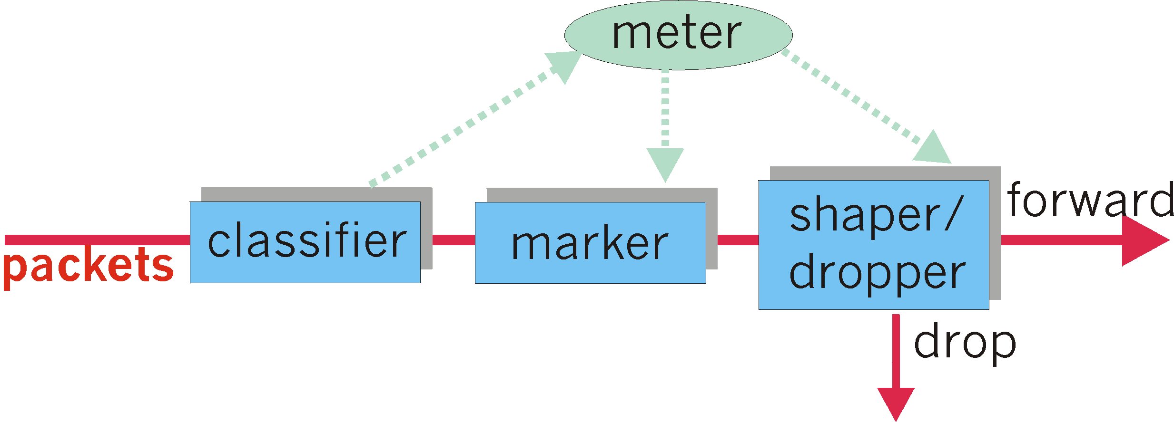
Classification and Conditioning
may be desirable to limit traffic injection rate of some class:
user declares traffic profile (e.g., rate, burst size)
traffic metered, shaped if non-conforming

Slide 89
Forwarding (PHB)
PHB result in a different observable (measurable) forwarding performance behavior
PHB does not specify what mechanisms to use to ensure required PHB performance behavior
Examples:
Class A gets x% of outgoing link bandwidth over time intervals of a specified length
Class A packets leave first before packets from class B

Slide 90
Forwarding (PHB)
PHBs being developed:
Expedited Forwarding: pkt departure rate of a class equals or exceeds specified rate
logical link with a minimum guaranteed rate
Assured Forwarding: 4 classes of traffic
each guaranteed minimum amount of bandwidth
each with three drop preference partitions

Slide 91
Chapter 7 outline
7.1 multimedia networking applications
7.2 streaming stored audio and video
7.3 making the best out of best effort service
7.4 protocols for real-time interactive applications
RTP, RTCP, SIP
7.5 providing multiple classes of service
7.6 providing QoS guarantees

Slide 92
Chapter 7 outline
7.1 Multimedia Networking Applications
7.2 Streaming stored audio and video
7.3 Real-time Multimedia: Internet Phone study
7.4 Protocols for Real-Time Interactive Applications
RTP,RTCP,SIP
7.5 Distributing Multimedia: content distribution networks
7.6 Beyond Best Effort
7.7 Scheduling and Policing Mechanisms
7.8 Integrated Services and Differentiated Services
7.9 RSVP

Slide 93
Principles for QOS Guarantees (more)
Basic fact of life: can not support traffic demands beyond link capacity
1 Mbps
phone
R1
R2
1 Mbps
phone
1.5 Mbps link
Principle 4
Call Admission: flow declares its needs, network may
block call (e.g., busy signal) if it cannot meet needs

Slide 94
QoS guarantee scenario
Resource reservation
call setup, signaling (RSVP)
traffic, QoS declaration
per-element admission control
request/
reply
QoS-sensitive scheduling (e.g., WFQ)

Slide 95
IETF Integrated Services
architecture for providing QOS guarantees in IP networks for individual application sessions
resource reservation: routers maintain state info (a la VC) of allocated resources, QoS req’s
admit/deny new call setup requests:
Question: can newly arriving flow be admitted
with performance guarantees while not violated
QoS guarantees made to already admitted flows?

Slide 96
Call Admission
Arriving session must :
declare its QOS requirement
R-spec: defines the QOS being requested
characterize traffic it will send into network
T-spec: defines traffic characteristics
signaling protocol: needed to carry R-spec and T-spec to routers (where reservation is required)
RSVP

Slide 97
Intserv QoS: Service models [rfc2211, rfc 2212]
Guaranteed service:
worst case traffic arrival: leaky-bucket-policed source
simple (mathematically provable) bound on delay [Parekh 1992, Cruz 1988]
Controlled load service:
"a quality of service closely approximating the QoS that same flow would receive from an unloaded network element."
arriving
traffic
token rate, r
bucket size, b
per-flow
rate, R
WFQ
D = b/R
max

Slide 98
Signaling in the Internet
connectionless (stateless) forwarding by IP routers
no network signaling protocols
in initial IP design
+
best effort service
=
New requirement: reserve resources along end-to-end path (end system, routers) for QoS for multimedia applications
RSVP: Resource Reservation Protocol [RFC 2205]
“ … allow users to communicate requirements to network in robust and efficient way.” i.e., signaling !
earlier Internet Signaling protocol: ST-II [RFC 1819]

Slide 99
RSVP Design Goals
accommodate heterogeneous receivers (different bandwidth along paths)
accommodate different applications with different resource requirements
make multicast a first class service, with adaptation to multicast group membership
leverage existing multicast/unicast routing, with adaptation to changes in underlying unicast, multicast routes
control protocol overhead to grow (at worst) linear in # receivers
modular design for heterogeneous underlying technologies

Slide 100
RSVP: does not…
specify how resources are to be reserved
rather: a mechanism for communicating needs
determine routes packets will take
that’s the job of routing protocols
signaling decoupled from routing
interact with forwarding of packets
separation of control (signaling) and data (forwarding) planes

Slide 101
RSVP: overview of operation
senders, receiver join a multicast group
done outside of RSVP
senders need not join group
sender-to-network signaling
path message: make sender presence known to routers
path teardown: delete sender’s path state from routers
receiver-to-network signaling
reservation message: reserve resources from sender(s) to receiver
reservation teardown: remove receiver reservations
network-to-end-system signaling
path error
reservation error

Slide 102
Chapter 7: Summary
Principles
classify multimedia applications
identify network services applications need
making the best of best effort service
Protocols and Architectures
specific protocols for best-effort
mechanisms for providing QoS
architectures for QoS
multiple classes of service
QoS guarantees, admission control

